Slide 1
Agrégation spatiotemporelle pour la visualisation de traces d’exécution
Damien Dosimont
Advisor: Guillaume Huard – Co-advisor: Jean-Marc Vincent

Slide 2



In a few words…
Analysis of large execution traces, provided by
multimedia/embedded applications
parallel/scientific computing applications
Design of a method based on
visualization
data aggregation
interaction
following a top down approach
Design and implementation in an analysis software

Slide 3
Summary

Slide 4

Context

Slide 5



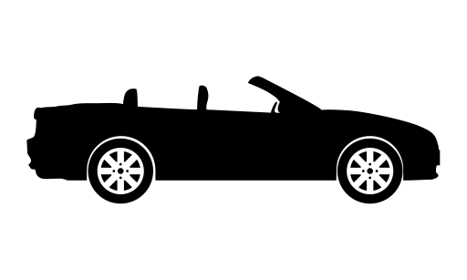





Embedded systems are everywhere!
SoC-Trace

Slide 6





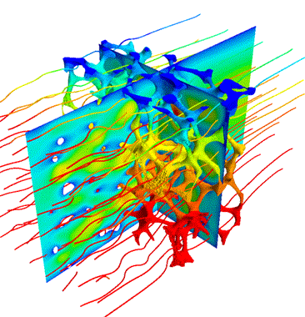








Large scale parallel and distributed systems too

Slide 7
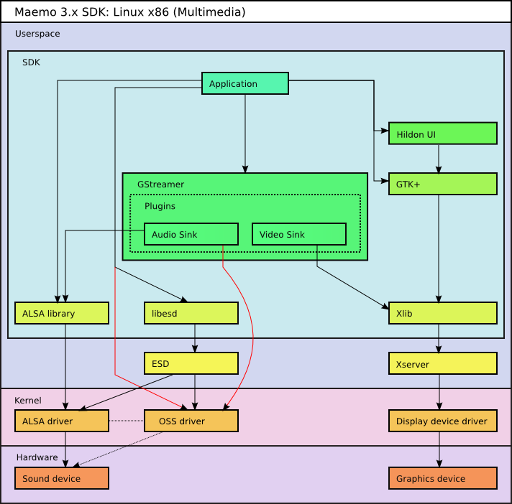
Complexity of multimedia applications

Slide 8
Complexity of large scale parallel systems

Slide 9

How to analyze these applications?
?

Slide 10

May the quality of service be with you

Slide 11


QoS not respected !
Loss of frames, sound artifacts
i find Your lack of qos disturbing

Slide 12



How to debug our application?
Classic step-by-step debugger (ex: GDB) not compatible with streaming/real time aspect
Trace Analysis
Tracing: collect information about the execution and save them in a file
Analyze the content post-mortem
Visualization techniques

Slide 13






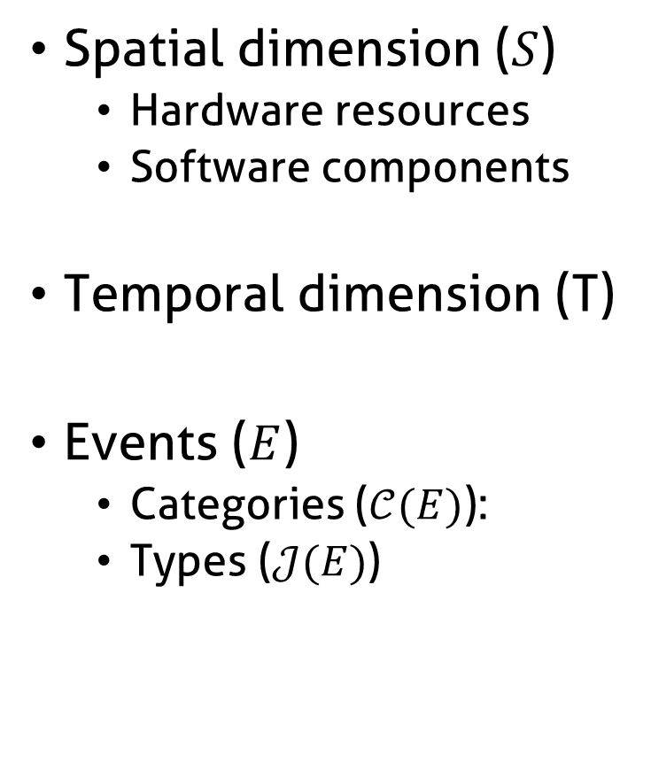
Information contained in traces
Spatial dimension ($S$)
Hardware resources
Software components
Temporal dimension (T)
Events ($E$)
Categories ($𝒞(E)$):
Types ($𝒥(E)$)

Slide 14
Visualize structure and temporal behavior
Space-time diagram inspired by Gantt Chart
Exemple of a sequential pattern with context switches
Exemple of a parallel execution with communications

Slide 15
How we imagine analyzing the application

Slide 16

How we imagine analyzing the application

Slide 17
How we imagine analyzing the application
Function green(){
…
}
Function red(){
…
}
Function purple(){
…
}

Slide 18
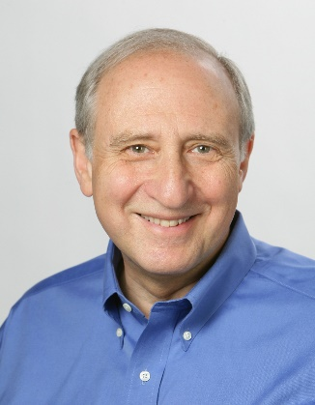




Shneiderman’s mantra
Overview first,
Zoom
and
Filter,
then
Details-on-demand
}

Slide 19





What about scalability?

Slide 20
Visualization support
+
=
≈
6 graphical objects
4 available pixels
Fitting graphical
objects with pixels
Final representation:
-some objects are lost
-proportions are not kept

Slide 21

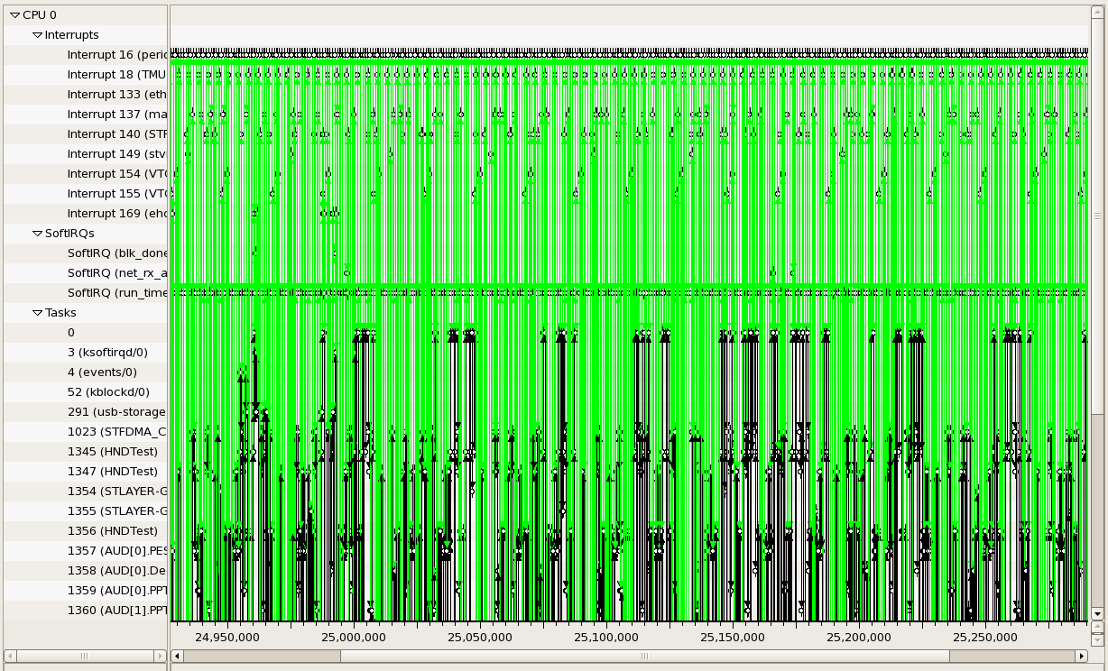
Visualization support

Slide 22
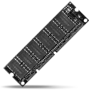


Performance
Memory Limitations
Hardware performance
Algorithmic complexity
Libraries, components, languages, etc.

Slide 23

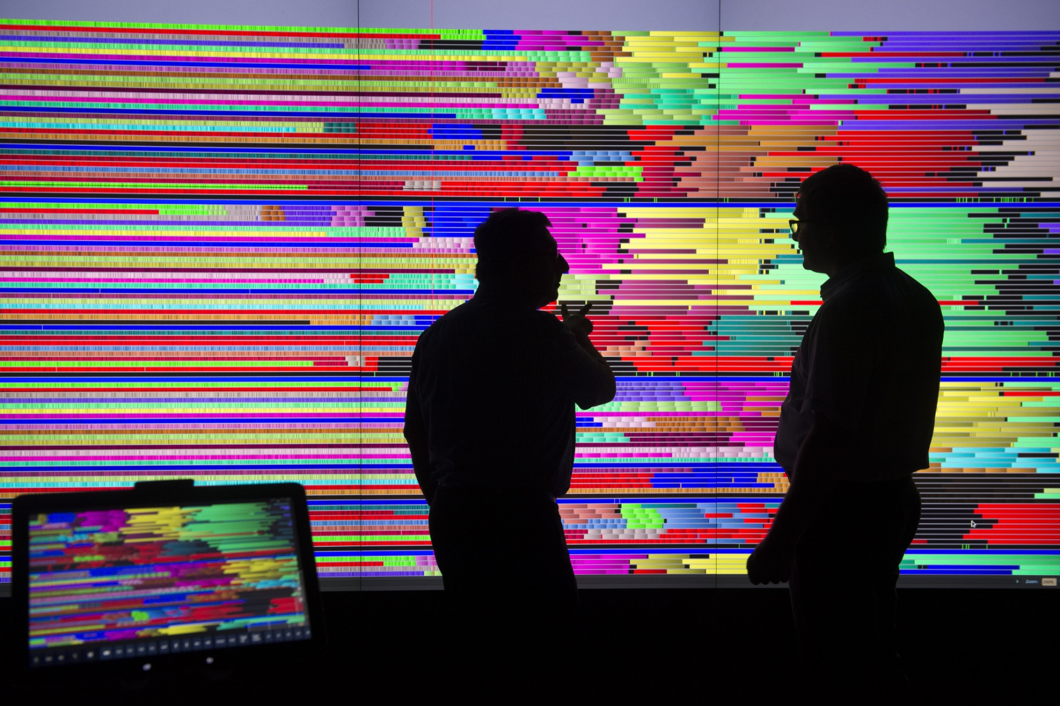
User

Slide 24

Shneiderman’s mantra
Overview first,
Zoom
and
Filter,
then
Details-on-demand
}

Slide 25

Proposal

Slide 26
Framework for spatiotemporal analysis
Respect shneiderman’s mantra
Theoretical contributions
Implementation

Slide 27
Overviews
Temporal, spatiotemporal
Build upon aggregation method (LP)
Notable Extension
Pipeline -> trace -> visu

Slide 28
Ocelotl Analysis Tool

Slide 29
Scalability and aggregation

Slide 30
Aggregation
General definition
Some properties
Examples

Slide 31
Aggregated representations
Data, visual, hybrid aggregations

Slide 32
What is a good overview?
Elmqvist and Fekete

Slide 33
Why exisiting methods are not satisfying?
Give some examples

Slide 34
Our approach is different

Slide 35
Lamarche-Perrin’s Method

Slide 36


Multi agent system analysis

Slide 37
Reduce complexity while keeping information

Slide 38

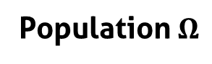
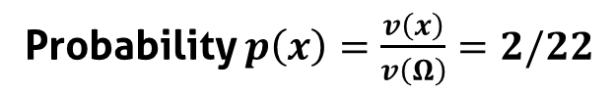
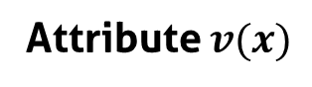
Population, individuals, attributes
Population $Ω$
5
1
Individuals $x$
9
1
4
2
Attribute $v(x)$
Probability $p\left(x\right)=\frac{v\left(x\right)}{v\left(Ω\right)}=2/22$

Slide 39
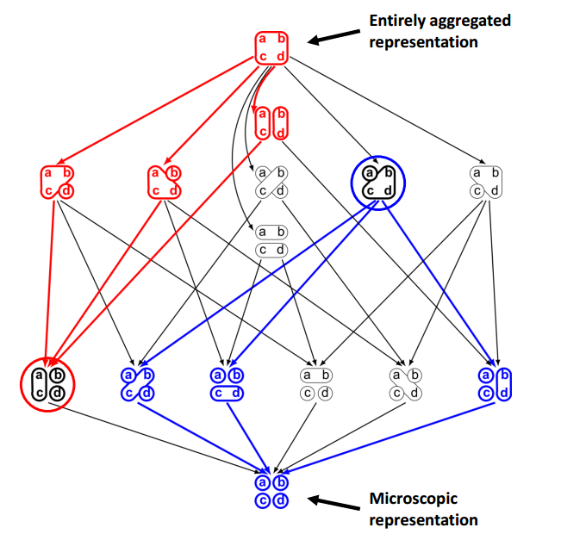
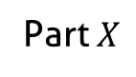
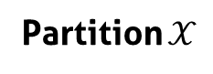
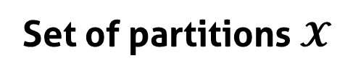
Partition the population
Set of partitions $𝓧$
Part $X$
5
1
9
1
Partial order
2
4
Partition $𝒳$

Slide 40
From the partition to the interpretation
5
5
1
15
5
9
5
1
1
1
2
6
3
4
3
Partition
Aggregation
(sum)
Redistribution
(uniform)
Visualization

Slide 41
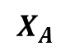
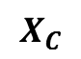
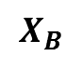
Best Partition problem
Find the partitions that maximize (minimize) quality measures
Quality measures are monotone, decomposable, and may be additive
$$X_{A}$$
$$Quality(𝒳) = Quality(X_{A}) + Quality(X_{B}) + Quality(X_{C})$$
5
1
9
1
$$X_{B}$$
2
4
$$X_{C}$$

Slide 42
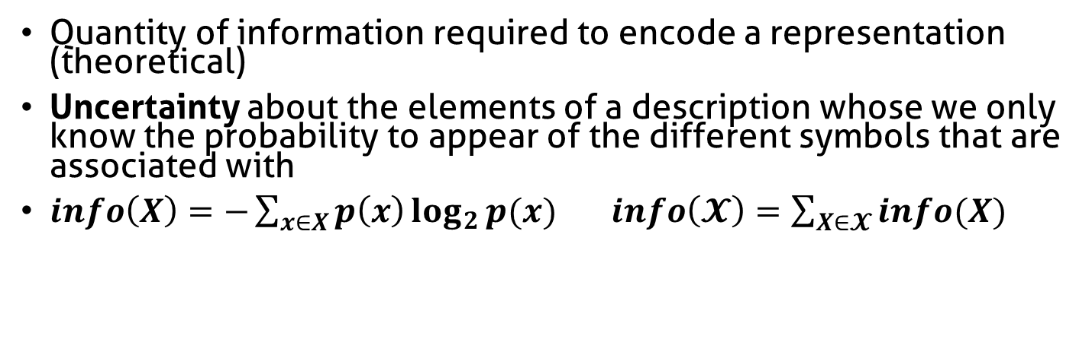
Complexity
Quantity of information required to encode a representation (theoretical)
Uncertainty about the elements of a description whose we only know the probability to appear of the different symbols that are associated with
$info\left(X\right)=−\sum_{x∈X}{p\left(x\right)\log_{2}{p(x)}}$ $info\left(𝓧\right)=\sum_{X∈𝓧}{info(X)}$
Complexity
5
5
5
1
1
1
1
1
1
9
9
9
2
2
2
4
4
4
Number of elements (aggregates)

Slide 43
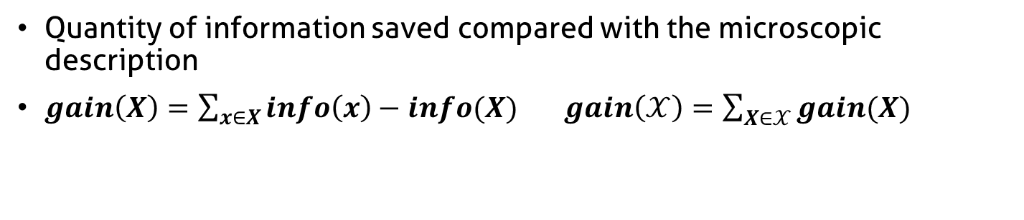
Complexity reduction
Quantity of information saved compared with the microscopic description
$gain\left(X\right)=\sum_{x∈X}{info\left(x\right)−info(X)}$ $gain\left(𝒳\right)=\sum_{X∈𝒳}{gain(X)}$
Complexity reduction
5
5
5
1
1
1
1
1
1
9
9
9
2
2
2
4
4
4
Number of elements (aggregates)

Slide 44
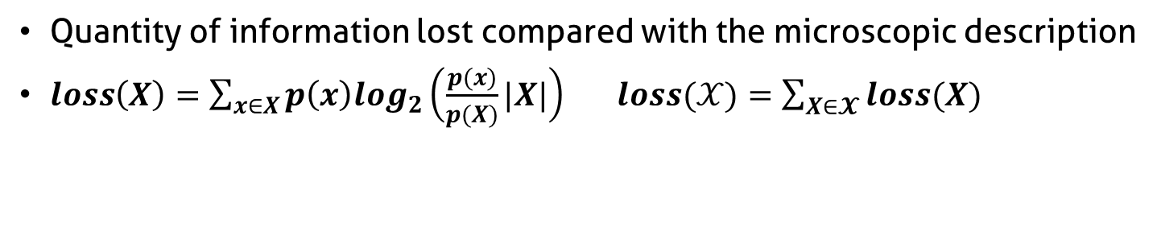
Information Loss
Quantity of information lost compared with the microscopic description
$loss\left(X\right)=\sum_{x∈X}{p\left(x\right)log_{2}\left(\frac{p(x)}{p(X)}|X|\right)}$ $loss(𝒳)=\sum_{X∈𝓧}{loss(X)}$
5
High
Information Loss
4
1
1
4
4
9
4
4
4
4
4
5
Low
Information Loss
4
4
4
4
4
4
4
4
4
3
4

Slide 45
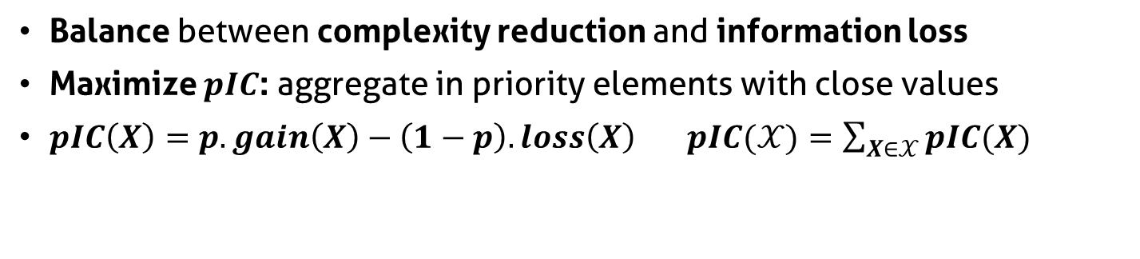
Parametrized Information Criterion
Balance between complexity reduction and information loss
Maximize $pIC$: aggregate in priority elements with close values
$pIC\left(X\right)=p.gain\left(X\right)−\left(1−p\right).loss\left(X\right)$ $pIC(𝒳)=\sum_{X∈𝒳}{pIC(X)}$
Parameter p
Complexity reduction
5
5
5
1
1
1
1
1
1
9
9
9
2
2
2
4
4
4
Information loss

Slide 46


Aggregation constraints
Decrease algorithmic complexity
Bring coherence with syntaxic and semantic characteristics of the system

Slide 47
How to build a polynomial algorithm?
Dynamic programming (divide and conquer)
Covering relationship (lattice)
Quality measure additivity

Slide 48

Temporal Analysis

Slide 49
Interest of Temporal Analysis

Slide 50







How to adapt LP method to trace analysis?
?
?
Trace =
Nanoscopic
Model
Microscopic
Model
Qualities
Partition
Abstraction
Visualization

Slide 51
Build a microscopic model from the trace
?
?
Trace =
Nanoscopic
Model
Microscopic
Model
Qualities
Partition
Abstraction
Visualization

Slide 52
Build a microscopic model from the trace
Trace =
Nanoscopic
Model
Discretization
Microscopic
Model
Time continuous
Space discrete
Event types discrete
Time discrete
Space discrete
Event types discrete

Slide 53
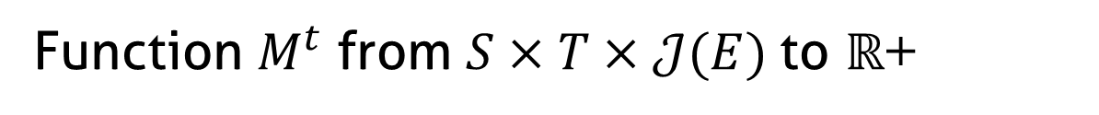
Microscopic model structure
Function $M^{t}$ from $S×T×𝒥(E)$to $ℝ$+
J5
J4
J3
Event types
J2
J1
s1
Space
s2
s3
t1
t2
t3
t4
t5
Time (discrete)

Slide 54
Fill the microscopic model
Time (continuous)
Sum of state durations
s1
s2
Time slice
Space
s3
d1 + d2 + p1*d3
s1
d1+d2+p1*d3
s2
Space
s3
t1
t2
t3
t4
t5
Time (discrete)

Slide 55
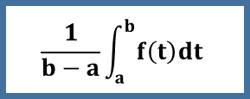
Fill the microscopic model
Event occurrences
Average state duration
Variable mean
Time slice
Time slice
Time slice
1 + 1 + 1
d1 + d2 + p1*d3
a
b
3
(d1+d2+p1*d3)/3
$$\frac{1}{b−a}\int_{a}^{b}{f\left(t\right)dt}$$

Slide 56
Aggregate the microscopic model
Original algorithm:
scalar values
t1
t2
t3
t4
t5
Time (discrete)
Objective:
multidimensional
values
t1
t2
t3
t4
t5
Time (discrete)

Slide 57
Adapt the quality computation
?
Trace =
Nanoscopic
Model
Microscopic
Model
Qualities
Partition
Abstraction
Visualization

Slide 58
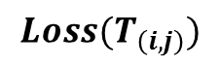
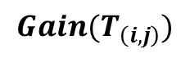
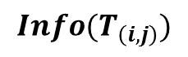
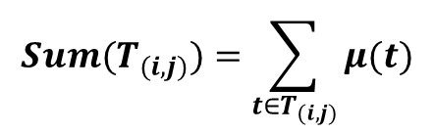
Quality computation of monodimensional values
Monodimensional microscopic model
Intermediate measures
$$Sum(T_{(i,j)})=\sum_{{t∈T}_{(i,j)}}{μ(t)}$$
Time (discrete)
Data structure of time intervals T(i,j)
$$Info(T_{\left(i,j\right)})$$
Quality measures
i
$$Gain(T_{\left(i,j\right)})$$
$$Loss(T_{\left(i,j\right)})$$
j

Slide 59
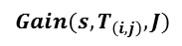
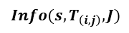
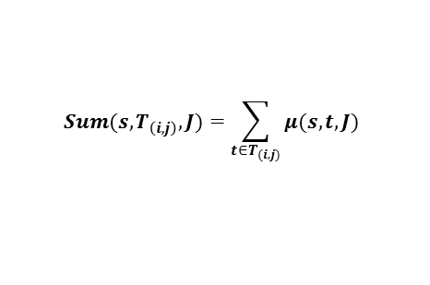
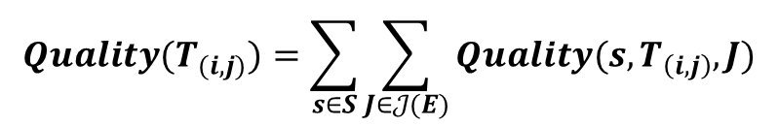
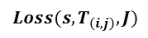
Quality computation of multidimensional values
Intermediate measures
$$Sum(s,T_{\left(i,j\right)},J)=\sum_{{t∈T}_{(i,j)}}{μ(s,t,J)}$$
Jr
Jb
s1
$$Info({s,T}_{\left(i,j\right)},J)$$
Quality measures
s2
$$Gain(s,T_{\left(i,j\right)},J)$$
$$Loss(s,T_{\left(i,j\right)},J)$$
=
+
+
+
$$Quality(T_{(i,j)})=\sum_{s∈S}{\sum_{J∈𝒥(E)}{Quality(s,T_{\left(i,j\right)},J)}}$$

Slide 60
Best cut computation
?
Trace =
Nanoscopic
Model
Microscopic
Model
Qualities
Partition
Abstraction
Visualization
Identical to algorithm scalar version!

Slide 61
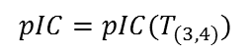
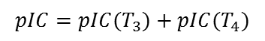
Best cut computation
Compute, compare, and select pIC for time intervals
pIC=p*gain-(1-p)*loss
User provides p
Already
computed
Ex: 4 time slices
$$pIC=pIC(T_{3})+pIC(T_{4})$$
Possible cuts: Cut[i]
i=4
Cut[4]=4
$$pIC=pIC(T_{(3,4)})$$
i=3
or
Cut[3]=3 or 4
i=2
or
or
Cut[2]=2, 3 or 4
or
or
i=1
Cut[1]=1, 2, 3 or 4
or

Slide 62

Rebuild the best partition
Example
Cut[1]?
Cut[1]=2
Cut[2+1]?
Cut[3]=3
Cut[3+1]?
Cut[4]=4
Best Partition

Slide 63
Interpret the aggregation result
?
Trace =
Nanoscopic
Model
Microscopic
Model
Qualities
Partition
Abstraction
Visualization

Slide 64
Aggregate and redistribute the values
Microscopic model
Partition
?
Aggregation (sum)
!
Uniform redistribution

Slide 65
Visualize the trace abstraction
?
Trace =
Nanoscopic
Model
Microscopic
Model
Qualities
Partition
Abstraction
Visualization

Slide 66
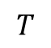
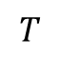
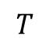
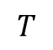
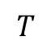
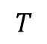
Visualize the trace abstraction
Bar chart
$$T$$
Colored
partition
$$T$$
$$T$$
Stacked bar
chart
$$T$$
$$T$$
Mode
$$T$$
Spatial aggregation
Aggregation of event types

Slide 67
Stacked bar chart visual aggregation
minimal height
blue + orange event type
total height < minimal height
blue event type
height < minimal height
blue + orange event type
individual height < minimal height
total height > minimal height
Decrease available height

Slide 68
Example of analyses

Slide 69
TS Record

Slide 70
Conjugate Gradient

Slide 71
We need some space!

Slide 72

Spatiotemporal Analysis
+

Slide 73
Interest of spatiotemporal analysis

Slide 74
Build a microscopic model from the trace
Trace =
Nanoscopic
Model
Discretization
+ Hierarchization
Microscopic
Model
Time continuous
Space flat
Event types discrete
Time discrete
Space hierachized
Event types discrete

Slide 75

Microscopic model structure
Function $M^{st}$ from $S×T×𝒥(E)$to $ℝ$+
Event types
J3
J2
J1
s1
s2
Space
s3
s4
s5
t1
t2
t3
t4
t5
Time (discrete)

Slide 76





Hardware/software hierarchy
Hardware components
Site
Clusters
Nodes
Cores
Threads
Software components

Slide 77
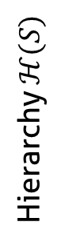
Hierarchize the spatial dimension
Event types
J3
J2
J1
s1
Sa
s2
Hierarchy $ℋ(S)$
s3
S
s4
Sb
s5
t1
t2
t3
t4
t5
Time (discrete)

Slide 78
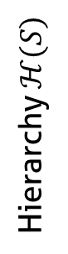
Aggregate the microscopic model
s1
Sa
s2
Hierarchy $ℋ(S)$
s3
S
s4
Sb
s5
t1
t2
t3
t4
t5
Time (discrete)

Slide 79
Forbidden Aggregates
s1
Sa
s2
Hierarchy $ℋ(S)$
s3
S
s4
Sb
s5
t1
t2
t3
t4
t5
Time (discrete)

Slide 80
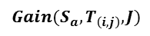
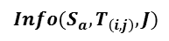
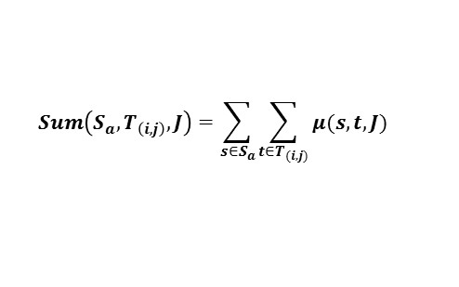
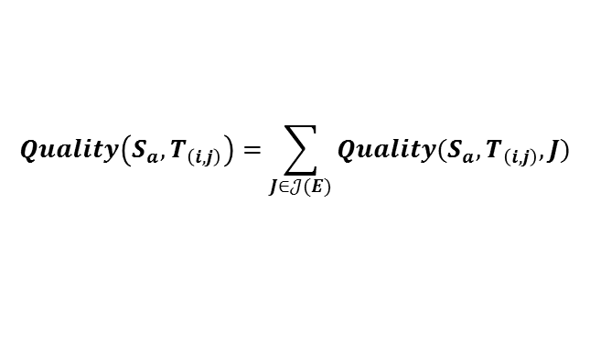
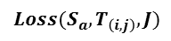
Quality computation
Intermediate measures
Quality measures
$$Sum\left(S_{a},T_{\left(i,j\right)},J\right)=\sum_{s∈S_{a}}{\sum_{{t∈T}_{(i,j)}}{μ(s,t,J)}}$$
$$Gain(S_{a},T_{\left(i,j\right)},J)$$
$$Info({S_{a},T}_{\left(i,j\right)},J)$$
$$Loss(S_{a},T_{\left(i,j\right)},J)$$
$$Quality\left(S_{a},T_{\left(i,j\right)}\right)=\sum_{J∈𝒥(E)}{Quality(S_{a},T_{\left(i,j\right)},J)}$$
s1
=
+
S
s2
=
+
=
+

Slide 81
Aggregation algorithm
Best cut: sequence of spatial and temporal cuts
Aggregation, redistribution: principle similar to temporal algorithm

Slide 82
Aggregate the microscopic model

Slide 83
Visual aggregation
Decrease available height

Slide 84
Example of analyses

Slide 85
Lower Upper Gauss Siedel

Slide 86
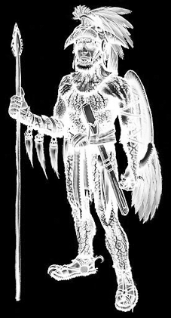
Implementation: Ocelotl Analysis Tool

Slide 87
Ocelotl Architecture

Slide 88
Framesoc

Slide 90
Conclusion

Slide 91
Publications
International Conferences
A Spatiotemporal Data Aggregation Technique for Performance Analysis of Large-scale Execution Traces. Damien Dosimont, Robin Lamarche-Perrin, Lucas Mello Schorr, Guillaume Huard, Jean-Marc Vincent, IEEE Cluster 2014, pages 149-157, Madrid, September 2014.
Efficient Analysis Methodology For Huge Application Traces. Damien Dosimont, Generoso Pagano, Guillaume Huard, Vania Marangozova-Martin, Jean-Marc Vincent, 2014 International Conference on High Performance Computing & Simulation, pages 951-958, Bologna, June 2014.
Trace Management and Analysis for Embedded Systems. Generoso Pagano, Damien Dosimont, Guillaume Huard, Vania Marangozova-Martin, Jean-Marc Vincent, 2013 IEEE 7th International Symposium on Embedded Multicore Socs (MCSoC), pages 119-122, Tokyo, September 2013.
Workshops
Ocelotl: Large Trace Overviews Based on Multidimensional Data Aggregation. Damien Dosimont, Youenn Corre, Lucas Mello Schnorr, Guillaume Huard, Jean-Marc Vincent, 8th International Parallel Tools Workshop (IPTW’14), Stuttgart, October 2014.
Agrégation temporelle pour l’analyse de traces volumineuses. Damien Dosimont, Guillaume Huard, Jean-Marc Vincent, 10ème Atelier en Evaluation de Performances, Sophia Antipolis, June 2014.
La visualisation de traces, support à l’analyse, déverminage et optimisation d’applications de calcul haute performance. Damien Dosimont, Guillaume Huard, Jean-Marc Vincent, Atelier Visualisation d’informations, interaction et fouille de données (VIF) de la 13e Conférence Francophone sur l’Extraction et la Gestion des Connaissances (EGC’2013), pages 55-66, Toulouse, January 2013.

Slide 92
Backup

Slide 93


Main thread: a recording application
Streaming
Record
TV program
Set-top box
Hard drive
TS Record use case

Slide 94


Knowledge on TS Record use case
IP buffers
Memory
Hard drive
IP packets
sys_write()
flush-8:0
every
100 ms
Disk cache
every
5000 ms
230 KB

Slide 95
How to adapt LP method to spatiotemporal analysis?
?
?
?
?
?
Trace =
Nanoscopic
Model
Microscopic
Model
Qualities
Partition
Abstraction
Visualization

Slide 96
Microscopic model building
?
?
?
?
?
Trace =
Nanoscopic
Model
Microscopic
Model
Qualities
Partition
Abstraction
Visualization

Slide 97
Quality computation
?
?
?
?
Trace =
Nanoscopic
Model
Microscopic
Model
Qualities
Partition
Abstraction
Visualization

Slide 98
Best cut computation
?
?
?
Trace =
Nanoscopic
Model
Microscopic
Model
Qualities
Partition
Abstraction
Visualization

